Slide 1

NAPSS 2022
Virtual Sleep
Conference
Speakers

Slide 2
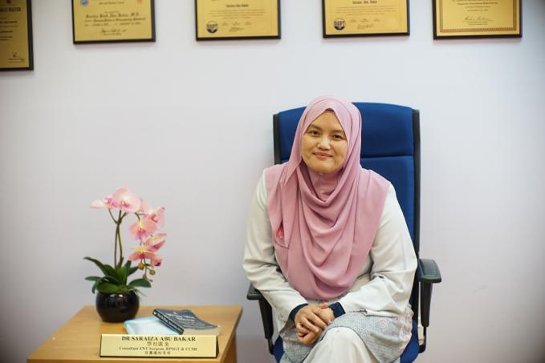
Saraiza is an ENT physician with special interest in pediatric otorhinolaryngology and pediatric sleep.
She graduated from National University of Malaysia (MD) in 1995, completed Otorhinolaryngology specialty training (MS-ORL) in 2002. Subspecialty training in Pediatric Otorhinolaryngology research fellow at Massachusetts Eye and Ear infirmary and Mass general Hospital (Harvard medical School) in 2007 and Pediatric Sleep surgery attachment at Lucille Packard Children Hospital and Sleep attachment Redwood city hospital (Stanford University) in 2014. She is also a Registered Polysomnographic Technologist (RPSGT) and Certification in Clinical Sleep Health (CCSH).
She is the current Head of Otorhinolaryngology Department at the Hospital Serdang and has published 4 books on sleep disorder and over 20 articles in journals.
Saraiza Abu Bakar,
M.D., RPSGT, CCSH
Notes:
Saraiza Abu Bakar is from Malaysia, an ENT physician with special interest in pediatric otorhinolaryngology and pediatric sleep. She graduated from National University of Malaysia Doctor of Medicine in 1995, completed Otorhinolaryngology specialty training and was awarded Master of Surgery- Otorhinolaryngology (MS-ORL) in 2002. Subspecialty training in Pediatric Otorhinolaryngology research fellow at Massachusette Eye and Ear infirmary and Mass general Hospital (Harvard medical School) in 2007 and Pediatric Sleep surgery attachment at Lucille Packard Children Hospital and Sleep attachment Redwood city hospital (Stanford University) in 2014. She also obtained 2 BRPT sleep certifications - Registered Polysomnographic Technologist (RPSGT) 2014 and Certification in Clinical Sleep Health (CCSH) in 2016.
She is the current Head of Otorhinolaryngology Department at the Hospital Serdang, Malaysia and has published four books on sleep disorder for layman and over 20 articles in journals.

Slide 3
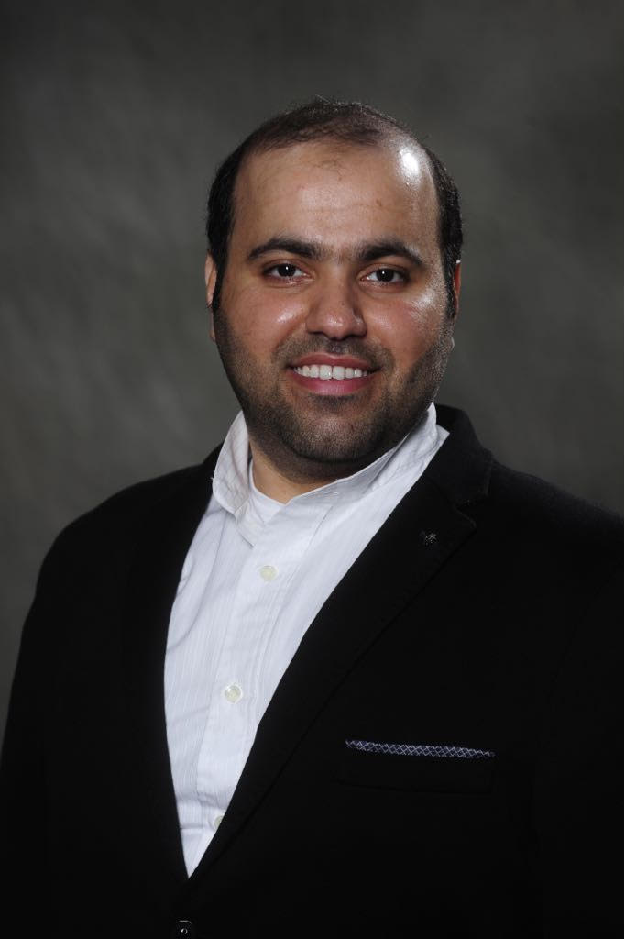
Dr. Ahmad Aldobyany is a Pulmonary and Sleep Medicne Consultant at King Abdullah Medical City in Mecca, Kingdom of Saudi Arabia.
He is also the director of Adult Pulmonary Fellowship Program.
He went through his adult pulmonary fellowship at National Guard Hospital, Jeddah, Saudi Arabia and did sleep medicine fellowship at McGill University, Montreal, Canada.
Ahmad Al-Dobyany M.D.

Slide 4
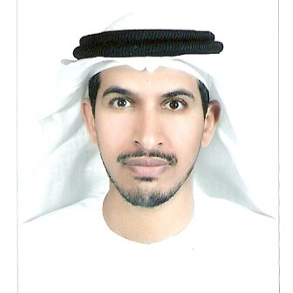
Dr. Al Houqani is the Associate Professor at the College of Medicine & Health
Sciences, UAEU & consultant of Respiratory & Sleep Medicine at Sleep
Disorders Specialized Clinic.
He did his post-graduate training at the University
of Toronto, Canada.
His research interest is focused around the
epidemiology of Respiratory and Sleep Disorders.
Dr. Mohammed Al-Houqani
MBBS, FRCPC, MPH

Slide 5
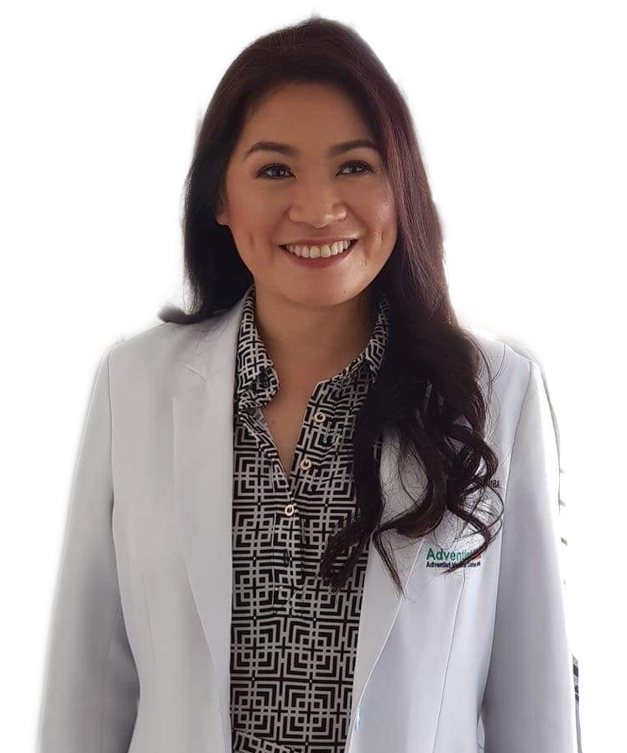
Dr. Jean is an alumna of Centro Escolar University, Manila, Philippines, graduating in 1998.
In her 23 years of practice, she specializes in various dental fields, including Sports Dentistry, hospital leadership and administration.
She accomplished the Mini Residency program for Orofacial Pain Management and Sleep Medicine at the University of Kentucky 2018.
Currently, she is into consultative practice of Dental Sleep and Sports Medicine at the Adventist Medical Center Manila, Dental Department, having served recently as the Chairman/ Department Head.
Jean Andaca-Bautista
DMD, FICCDE, MBA
IC-ABDSM
Notes:
Dr. Jean is an alumna of Centro Escolar University, Manila, Philippines, graduating in 1998. In her 23 years of practice, she equipped herself with a wide range of trainings covering many specialized dental fields, hospital leadership and administration, and other non-dental professional development seminars, locally and internationally. She also is a Dental educator having taught at the Adventist University of the Philippines (AUP) as well as establishing the Hospital Dentistry Residency, and Implantology and Oral Surgery courses in the hospital she used to head.
The past few years, her passion for sports brought her to specialize on Sports Dentistry. She finished a Team Dentist Course from the Academy for Sports Dentistry in San Francisco (2017) & New Orleans (2018) all in the USA. On the same year, alongside all these trainings she accomplished the Mini Residency program for Orofacial Pain Management and Sleep Medicine at the University of Kentucky 2018. She also was trained in Washington-Maryland in this area. Her most recent education allowed her to finish her Diplomate Mastery program from the American Academy for Dental Sleep Medicine from 2018 to 2019 and passing the AADSM Boards in 2020. Due to her varied exposures, she was invited to Chair the Sports Dentistry Symposium and share her experience at the 1st India Society of Dental Traumatology in New Delhi, India in 2018.
To improve her leadership at the Medical Center, she is currently completing her Doctor of Philosophy (PhD) Major in Business Management from the Philippine Christian University after finishing her MBA Major in Hospital Administration (Cum Laude) from Adventist University of the Philippines.
Currently, she is into consultative practice of Dental Sleep and Sports Medicine at the Adventist Medical Center Manila, Dental Department, having served recently as the Chairman/ Department Head.
Early 2018, Doc Jean established the Philippine Center for Sports Dentistry and Dental Sleep Medicine which provides the same specialization and trainings as the Center’s name indicates.
In addition to this, Doc Jean also advocates the spreading of knowledge and understanding of the field of dental sleep medicine through the following avenues: organizing and holding of seminars, providing awareness lectures to PDA-Chapters and Affiliates, focus-study group education, and free dental sports and sleep services to civil society organizations and NGOs, and TV-Radio guesting and government agencies including the Games and Amusement Boards (GAB) for our combat-sports athletes and an NCAA Volleyball Team. As of this day, she continues her dental health advocacy through scientific lectures on Sleep Medicine locally (among PDA chapters), as a lecturer in the Pulmo-Sleep Medicine of the Philippine Heart Center Residency Program, and internationally, while based in New York City, USA. She also hosts her own Youtube channel "Dok Jean" where she discuss issues related to Obstructive Sleep Apnea, snoring, and other sleep disorders.
Staying true to her personal philosophy, she has maintains her desire ”To serve the Lord wholeheartedly by achieving the highest professional excellence through formal education, training, and affiliations.”

Slide 6
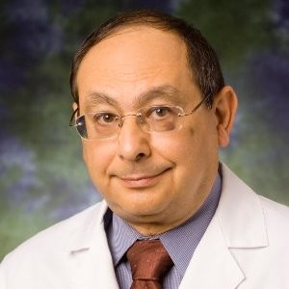
Richard Castriotta is a professor of Clinical Medicine at the University of Southern California Keck School of Medicine in Los Angeles, California.
He has served as Professor of Medicine and Director of the Division of Pulmonary, Critical Care and Sleep Medicine at the University of Texas Health Science Center at Houston, and Chief of Pulmonary Medicine, and Medical Director of the Sleep Disorders.
He is accomplished in the field of sleep disordered breathing and its relationship to cardiovascular disease, including complex sleep apnea, and has studied non-apneic sleep disordered breathing in the obese, as well as hypoventilation in various conditions.
Richard Castriotta
M.D., FCCP, FAASM
Notes:
Richard J. Castriotta, M.D., FCCP, FAASM is a Professor of Clinical Medicine at the University of Southern California Keck School of Medicine in Los Angeles and Professor Emeritus at the University of Texas Health Science Center at Houston McGovern Medical School. He has served as Professor of Medicine and Director of the Division of Pulmonary, Critical Care and Sleep Medicine at the University of Texas Health Science Center at Houston, and Chief of Pulmonary Medicine, and Medical Director of the Sleep Disorders Center and Pulmonary Physiology Laboratory at Memorial Hermann Hospital - Texas Medical Center in Houston. He has served as President of the Southern Sleep Society, Chair of the Connecticut Thoracic Society Section on Sleep Medicine, Chair of the American College of Chest Physicians (ACCP) Sleep NetWork Steering Committee and Chair of the Palliative Care and End-of-Life NetWork Steering Committee, Vice Chair of the Southern Medical Association Chest Disease Section and President of the Southern Sleep Foundation Board of Directors. He is a Fellow of the American Academy of Sleep Medicine and American College of Chest Physicians. He has been a pioneer in the field of sleep medicine, establishing one of the early formal sleep medicine training programs in 1999 (in Houston, Texas) and one of the early sleep disorders centers in 1981 (in Hartford, Connecticut). He is currently Medical Director of the Keck/USC Sleep Disorders Center in Los Angeles.
Dr. Castriotta conducted a landmark study of sleep disorders after traumatic brain injury (>300 citations). He has served on the U.S. Department of Defense Expert Panel for Clinical Recommendations on Management of Sleep Disturbances in Mild Traumatic Brain Injury. Dr. Castriotta has a long-term interest in REM sleep behavior disorder (RBD) and Parkinson’s disease, in collaboration with Dr. Mya Schiess and was a member of the International RBD Study Group. He is accomplished in the field of sleep disordered breathing and its relationship to cardiovascular disease, including complex sleep apnea, and has studied non-apneic sleep disordered breathing in the obese, as well as hypoventilation in various conditions.
Most recent publications:
1. Haghayegh S, Smolensky MH, Khoshnevis S, Hermida R, Castriotta RJ, Diller KR. The circadian rhythm of thermoregulation modulates both sleep/wake cycle and 24-hour pattern of arterial blood pressure. Compr Physiol 2021;11:1-14. DOI:10.1002/cphy.c210008. PMID: 34636410
2. Kumar V, Grbach VX, Castriotta RJ. Resolution of sexsomnia with paroxetine. J Clin Sleep Med 2020. https://doi.org/ 10.5664/jcsm.8478. EMID:89db22f54beffb02.
3. Geng YJ, Wei ZY, Qian HY, Huang J, Gao S, Shelat H, Lodato R, Castriotta RJ. Pathophysiological characteristics and therapeutic approaches for COVID-19 pulmonary injury and cardiovascular complications. Cardiovasc Path 2020;47:1-8. PMID: 32375085; PMCID: PMC7162778. https://doi.org/10.1016/j.carpath.2020.107228.
4. Haghayegh S, Koshnevis S, Smolensky MH, Diller KR, Castriotta RJ. Machine learning derived-interpretive algorithm better differentiates sleep and wake epochs and estimates sleep parameters from wrist actigraphy data. Sleep 2020;43:A457-458. https://doi.org/10.1093/sleep/zsaa056.1190.
5. Ellmore TM, Suescan J, Castriotta RJ, Schiess MC. A study of the relationship between uric acid and the substantia nigra brain connectivity in patients with REM sleep behavior disorder and Parkinson’s disease. Frontiers Neurology 2020;11:1-14 (Article 815).
Most cited publications:
1. Castriotta RJ, Wilde MC, Lai JM, Atanasov S, Masel BE, Kuna ST. Prevalence and consequences of sleep disorders in traumatic brain injury. J Clin Sleep Med 3(4):349-356, 2007. PMID: 17694722; PMCID: PMC1978308 (300 citations)
2. Gluck EH, Onorato DJ, Castriotta RJ. The use of helium-oxygen mixtures in intubated patients with status asthmaticus and respiratory acidosis. Chest 1998 (3): 693-698, 1990. PMID 2118449 (275 citations).
3. Kass JE, Castriotta RJ. Heliox therapy in acute severe asthma. Chest 107: 757-760, 1995. PMID: 7874949 (200 citations).
4. Smolensky MH, Hermida RC, Castriotta RJ , Portaluppi F. Role of sleep-wake cycle on blood pressure circadian rhythms and hypertension. Sleep Med 8(6):668-680, 2007. PMID: 17383936 (190 citations).
5. Kass JE, Castriotta RJ, Malakoff M. Intensive care unit outcome in the very elderly. Crit Care Med 20(12): 1666-71, 1992. (172 citations).

Slide 7
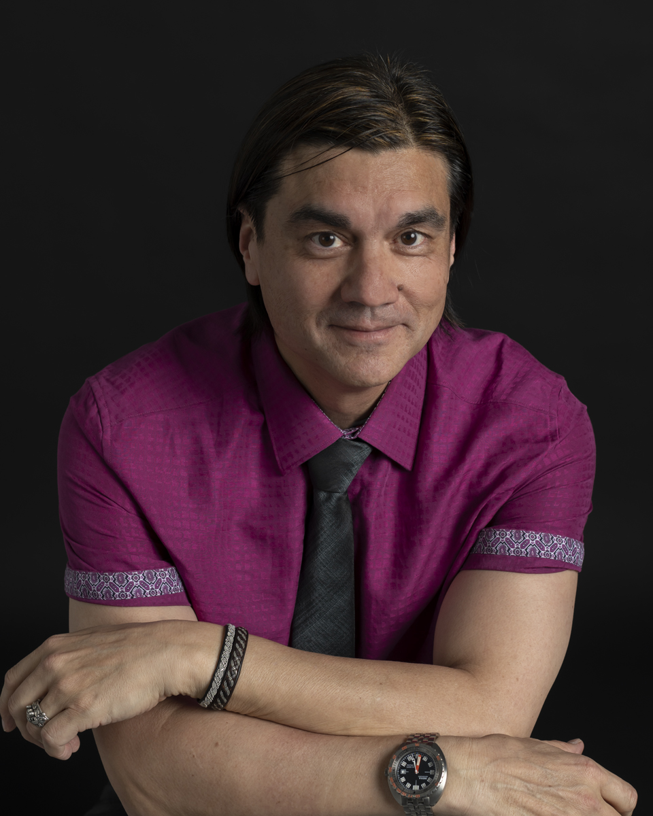
Michel is the Founder/Lead Investigator of Sleep Forensics Associates. He is also the co-director of Sleep Medicine Services at CentraCare Health in Saint Cloud, Minnesota. Dr. Cramer Bornemann had spent his entire career in academics having held appointments at the University Of Minnesota School Of Medicine in a joint appointment as an Assistant Professor in the Department of Neurology and the Department of Medicine. He remains involved in academic medicine and is a Visiting Professor of Sleep Medicine with the Sleep Medicine Fellowship Program at the Minnesota Regional Sleep Disorders Center at Hennepin County Medical Center in Minneapolis.
His primary focus has been regarding the forensics implications concerning sleep-related violence or complex Parasomnias. As such, he has been involved in over 400 criminal cases worldwide and has worked for both the defense and prosecution. In this regard, his work with Sleep Forensics Associates has been highlighted in the international media including National Geographic, BBC, Discovery Channel, and ABC Mysteries.
Michel Cramer-Bornemann
MD, DABSM, DABMS-SM, FAASM
Notes:
Michel A. Cramer Bornemann, MD, DABMS-SM, D-ABSM, FAASM is the Founder/Lead Investigator of Sleep Forensics Associates where he works alongside noted Parasomnia research pioneers, Mark W. Mahowald, MD and Carlos H. Schenck, MD, in furthering understanding of the spectrum of complex behaviors that may arise from Parasomnias along with its social and legal implications. The work of Sleep Forensics Associates has been highlighted in the international media including feature articles in Scientific American and the BBC. He has been very involved with the American Academy of Sleep Medicine having been the task force chair of the Parasomnia subsection for the most recent version the International Classification of Sleep Disorder 3rd edition (ICSD-3) and has been a member of the Parasomnia Steering Committee. Before dedicated the majority of his work in Sleep Forensics, Dr. Cramer Bornemann had spent his entire career
in academics having held appointments at the University Of Minnesota School Of Medicine in a joint appointment as an Assistant Professor in the Department of Neurology and the Department of Medicine. He remains involved in academic medicine as a Visiting Professor of the Sleep Medicine Fellowship Program at the Minnesota Regional Sleep Disorders Center at Hennepin County Medical Center in Minneapolis, Minnesota. In his practice, he enjoys the combination of clinic, research, forensic investigation, teaching, and writing.

Slide 8
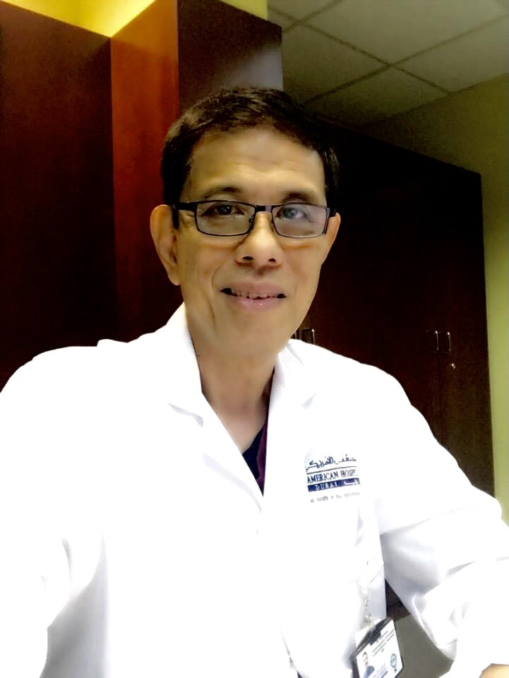
Ely Hibionada, MD, RPSGT is a
Sleep Doctor and an insomnia coach at Insomnia Clinic Baguio.
He had been practicing sleep medicine since 1999 in Canada, Dubai and the Philippines.
Past membership with the American Academy of Sleep Medicine, Canadian Sleep Society and an Associate member of the Philippine Society of Sleep Medicine.
He will be presenting on Coronasomnia.
Ely Hibionada, M.D., RPSGT
Notes:
Ely Hibionada, MD, RPSGT
Sleep Doctor and an insomnia coach at Insomnia Clinic Baguio. Had been practicing sleep medicine since 1999 in Canada, Dubai and the Philippines. Past membership with the American Academy of Sleep Medicine, Canadian Sleep Society and an Associate member of the Philippine Society of Sleep Medicine.

Slide 9
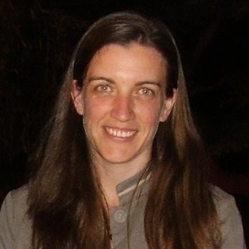
Kerri Melehan is a sleep scientist furthering sleep medicine education in Australia as well as sleep technology research, covering clinical work, education, and research - all within University of Sydney and Royal Prince Alfred hospital.
Kerri has been involved in teaching sleep medicine since 2006 and currently coordinating/teaching in the Masters of Sleep Medicine program, as well as the Fundamentals of Sleep Medicine at the University of Sydney.
She was the past President of the Australia and New Zealand Sleep Science Association and was also the ASTA representative for the BRPT examination (the RPSGT exam), established the ASTA Continuing Education Credit granting committee and served on the board of the Australasian Sleep Association.
Kerri Melehan, PhD, RPSGT
Notes:
Kerri Melehan is a sleep scientist with interests in furthering sleep medicine education in Australia as well as sleep technology research, covering clinical work, education, and research - all within University of Sydney and Royal Prince Alfred hospital, as well as providing consultative work for PSG analysis and sleep laboratory management.
Kerri has been involved in teaching sleep medicine since 2006 and currently coordinating/teaching in the Masters of Sleep Medicine program, as well as the Fundamentals of Sleep Medicine at the University of Sydney.
Research interests include the impact of sleep disorders on sexual function and relationships, the impacts of bed-sharing and the effect of the menstrual cycle on sleep in women. Her PhD examined using CPAP to improve erectile function in men with OSA. Other research interests involve investigating the intricacies of reporting sleep parameters using manual and automated techniques.
She was the past President of the Australia and New Zealand Sleep Science Association (previously known as the Australasian Sleep Technologist Association). She was also the ASTA representative for the BRPT examination (the RPSGT exam), established the ASTA Continuing Education Credit granting committee and served on the board of the Australasian Sleep Association.

Slide 10
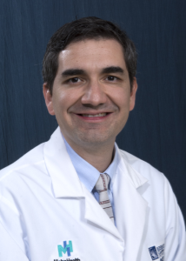
Dr. Paz y Mar completed his training in Internal Medicine, Sleep Medicine and Pulmonary/Critical Care Medicine at the Cleveland Clinic. He joined University of Southern California in 2021. His specialty interests include sleep-disordered breathing and Critical Care Medicine. In addition, his focus also includes medical education. Dr. Paz is the Director for the Sleep Medicine Fellowship Program.
Hugo Paz y Mar, M.D.
Notes:
Dr. Paz completed his training in Internal Medicine, Sleep Medicine and Pulmonary/Critical Care Medicine at the Cleveland Clinic. He joined University of Southern California in 2021. His specialty interests include sleep-disordered breathing and Critical Care Medicine. In addition, his focus also includes medical education. Dr. Paz is the Director for the Sleep Medicine Fellowship Program.

Slide 11
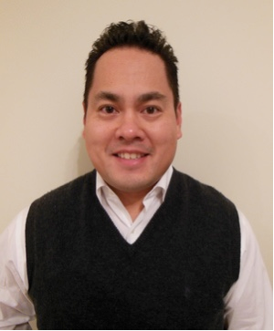
Joel Porquez is an experienced polysomnographer with an educational background that includes a Doctor of Medicine degree. He is a leader in the field having recently served on the Board of Directors and Executive Board for the American Association of Sleep Technologists (AAST). Joel is a published author in medical journals and textbooks, and he is part of the editorial advisory board for Sleep Review Journal. Joel enjoys speaking at local, regional, and national levels and has trained sleep professionals in performing pediatric studies as Founder & Principal of Sleepkidzzz. He currently works as a support specialist at Nox Medical.
Joel Porquez, BS, CCSH,
RPSGT, RST
Notes:
Joel Porquez is an experienced polysomnographer with an educational background that includes a Doctor of Medicine degree. He is a leader in the field having recently served on the Board of Directors and Executive Board for the American Association of Sleep Technologists (AAST). Joel is a published author in medical journals and textbooks, and he is part of the editorial advisory board for Sleep Review Journal. Joel enjoys speaking at local, regional, and national levels and has trained sleep professionals in performing pediatric studies as Founder & Principal of Sleepkidzzz. He currently works as a support specialist at Nox Medical.

Slide 12
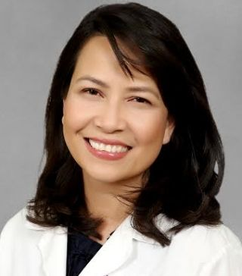
Mary Anne is a board - certified physician in sleep medicine, pediatric pulmonary and general pediatrics by the American Board of Pediatrics; clinical associate professor at Stanford University School of Medicine; practicing sleep medicine at Valley Children's Hospital, Lucille Packard Children's and another pediatric / adult sleep center.
Mary Anne Tablizo, M.D.

Slide 13
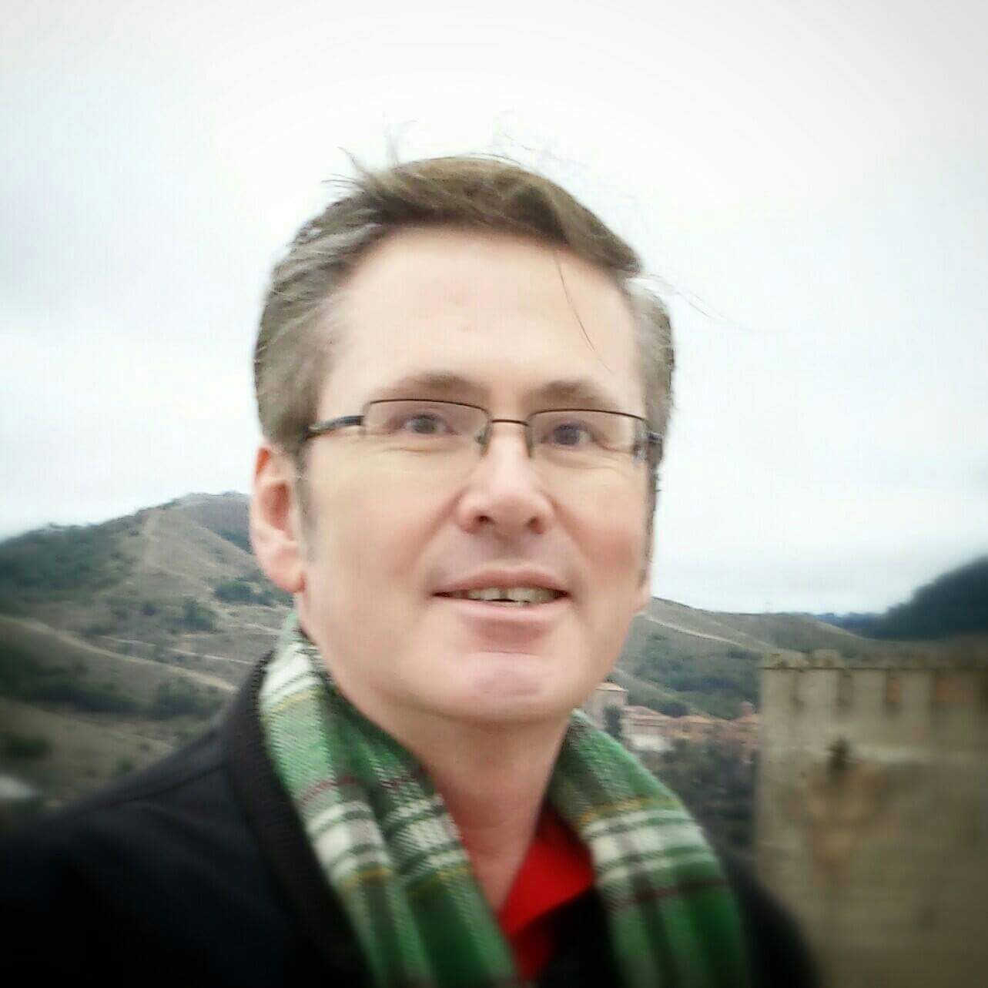
Robert Turner holds an associate degree in Respiratory Therapy from Boise State University, a Bachelor of Science in Health Care Administration from Eastern Michigan University and a Master of Science in Community Counseling from the University of Phoenix. He is a registered polysomnographic technologist, registered respiratory therapist and license professional counselor.
He has worked in sleep medicine for decades. He helped open new sleep centers in Michigan and New
Mexico. He is currently the clinical supervisor for the Sleep Disorders Center at Rose Medical Center in
Denver. He also has a general private practice counseling office in Littleton, CO.
He was the President of the AAST and one of the inaugural fellows of that organization. He has also
served as a board member for the BRPT. He has been a guest lecturer for the School of Sleep Medicine
in Palo Alto, CO and continues to serve as an advisor to the school. He has authored several articles and books chapters in professional publications as well as articles for consumer
publications.
Robert Turner, RRT, RPSGT

